Slide 1
Supervised Learning
Prof. Weijia Jia (賈維嘉 IEEE Fellow)
Office hour: Wed. 2—4pm, E11-4007, Thu. &;30—9pm, N21-1012a
Email: jiawj@umac.mo
https://www.fst.um.edu.mo/en/staff/jiawj.html

Slide 2
Supervised Learning Objectives
Use tagged/labeled data to learn the mapping:
input ➔(mapping) output ➔ apply this mapping to unknown data for classification or regression.
Classification: When the output is discrete, the learning task is a classification task.
Regression: When the output is continuous, the learning task is a regression task.

Slide 3

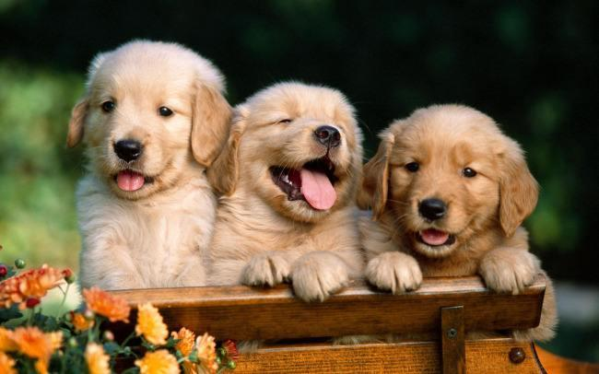
Classification Task
Cat?
Dog?
Classifier
Dog or Cat

Slide 4
Classified Learning
Input: A set of tagged training data (also known as observations and assessments) that indicate the type of data (observations).
Output: Based on input (training data), classification model trains the model parameters
➔ classifier -- suitable for input.
When new data (non-trained data) needs to be judged by category, the new data can be sent as input to the learned classifier for classification.

Slide 5
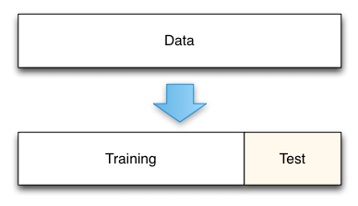
Classification Learning - Evaluation
Training set: Used to train the model’s labeled data to create models and discover patterns.
Testing set: Labeled data ➔ to hide the label and send it to the trained model. The result is compared with the real label to evaluate the learning ability of the model.

Slide 6
Classification Learning - Evaluation
Training set/test set -- existing annotation data -- is divided into
70% -- randomly selected as the training data,
30% -- used as the test data.
There is a cross-validation method, and the self-help method is used to evaluate the classification model.

Slide 7
Supervised Learning KNN

Slide 8
KNN (K-Nearest Neighbor Classification)
KNN: for both classification and regression predictive problems, more widely used in classification problems in the industry.
KNN fairs all parameters for its easy of interpretation and low calculation time.

Slide 9
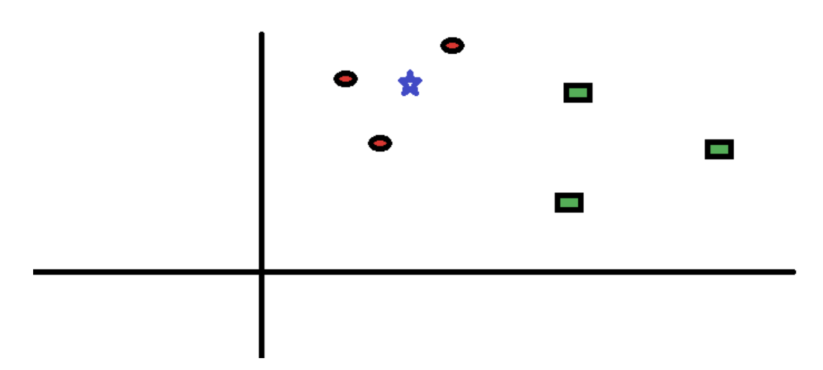
How does the KNN Algorithm work?
Simple case to understand KNN: With spread of red circles (RC) and green squares (GS): intend to find out the class of the blue star (BS). BS can either be RC or GS and nothing else.

Slide 10
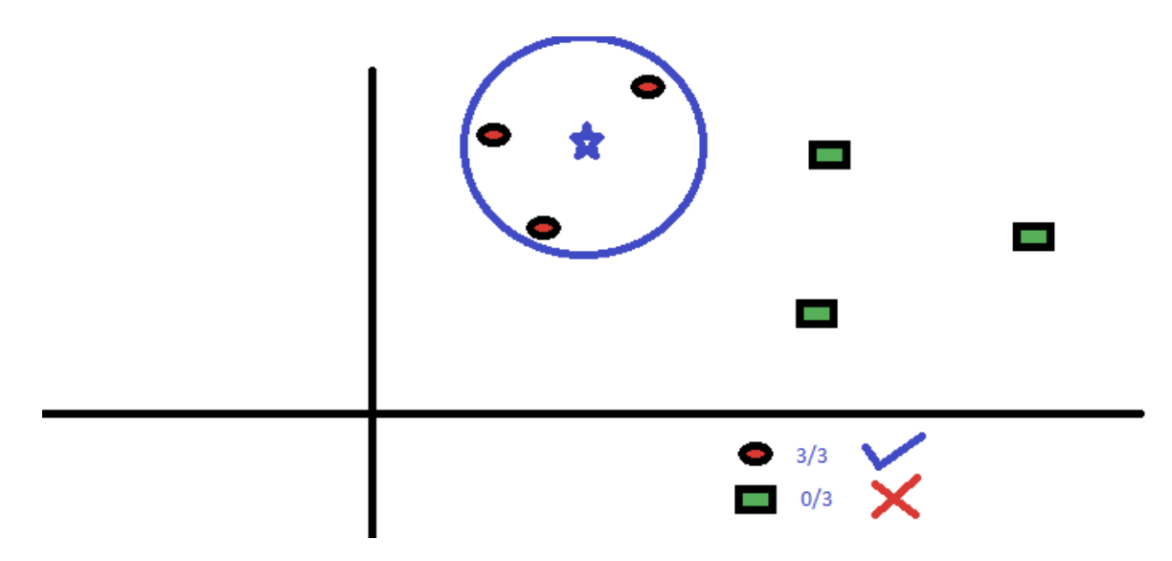
The “K” of KNN is the nearest neighbors we wish to take vote from. Say K = 3. Hence, we will now make a circle with Blue Star as center just to enclose only three data points on the plane.
The three closest points to BS is all RC. Good confidence ➔ BS should belong to the class RC.

Slide 11
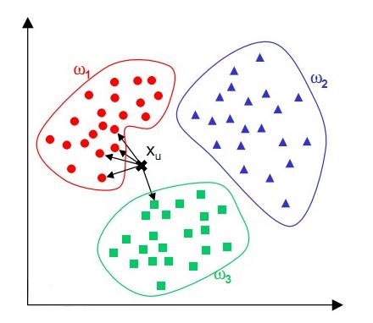
K Nearest Neighbor Classifier
KNN:
The distance from all data points in the existing data set by calculating the data points to be classified.
Take top K points with the smallest distances
Divide the data points into the most frequently occurring category according to
“Minority obeys Majority”.

Slide 12
Workflow of KNN
Load the data
Initialize the value of k
For getting the predicted class, iterate from 1 to total number of training data points
Calculate the distance between test data and each row of training data. Sort the calculated distances in ascending order based on distance values
Get top k rows from the sorted array
Get the most frequent class of these rows
Return the predicted class

Slide 13
K-Neighbors Regression
Prediction using a single neighbor is just the target value of the nearest neighbor.
In[19]:
mglearn.plots.plot_knn_regression(n_neighbors=1)

Slide 14
K-Neighbors Regression
When using multiple nearest neighbors, the prediction is the average, or mean, of the relevant neighbors
In[20]:
mglearn.plots.plot_knn_regression(n_neighbors=3)

Slide 15
K-Neighbors Regression
KNN for regression is implemented in the Kneighbors Regressor class in scikit-learn.
In[21]:
from sklearn.neighbors import KNeighborsRegressor
X, y = mglearn.datasets.make_wave(n_samples=40)
X_train, X_test, y_train, y_test = train_test_split(X, y, random_state=0)
reg = KNeighborsRegressor(n_neighbors=3)
reg.fit(X_train, y_train)
In[22]:
print("Test set predictions:\n{}".format(reg.predict(X_test)))

Slide 16
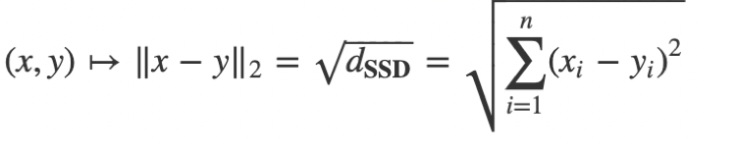
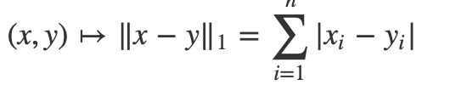
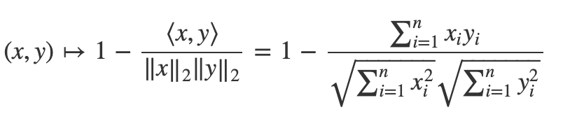
Different distance metric
1. Euclidean Distance
2. Manhattan Distance
3. Cosine Distance

Slide 17
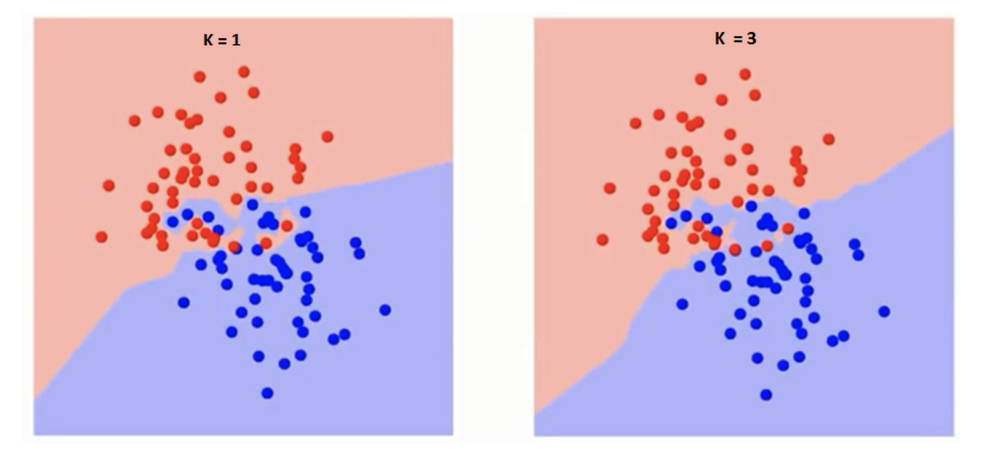
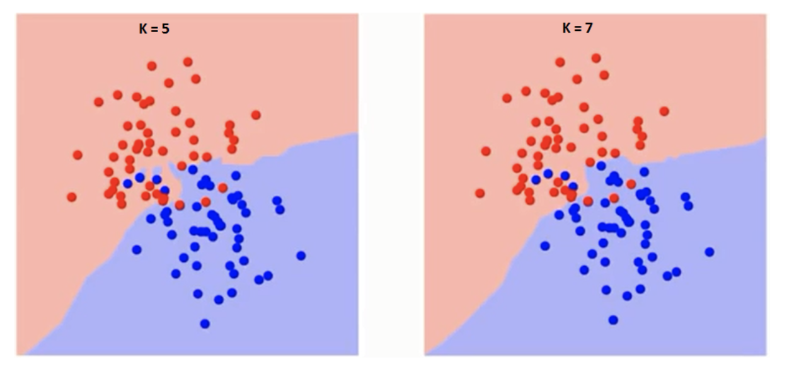
How do we choose the factor K?
The boundary becomes smoother with increasing value of K. With K increasing to infinity it finally becomes all blue or all red depending on the total majority.

Slide 18
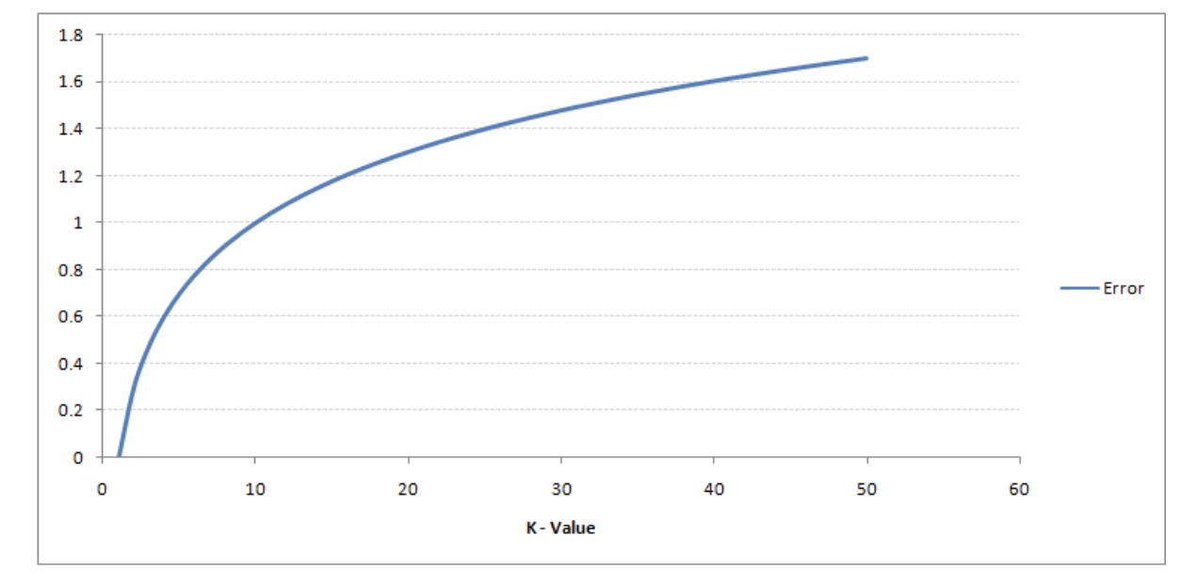
Curve for Training Error Rate
Training error rate and the validation error rate are two parameters we need to access on different K-value.
The error rate at K=1 is always zero for the training sample-- closest point to any training data point is itself. Hence the prediction is always accurate with K=1.

Slide 19
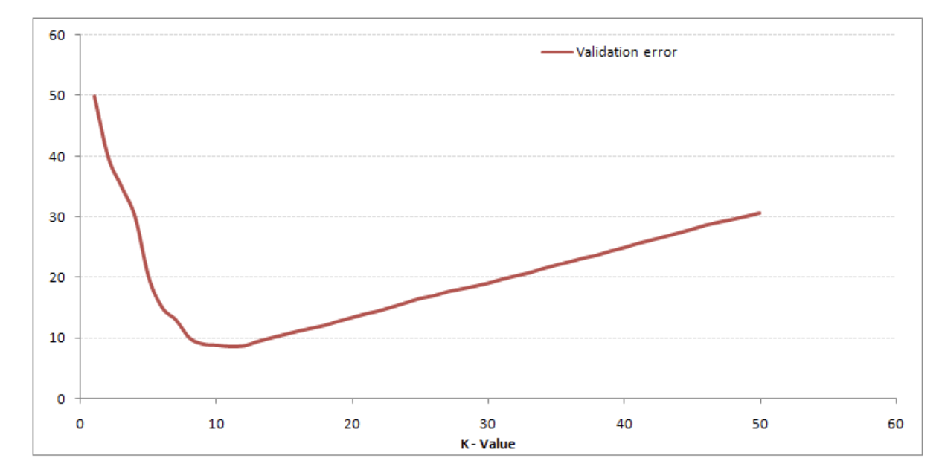
Curve for the validation error rate
K=1: overfitting the boundaries. Hence, error rate initially decreases and reaches a minima. After the minima point, it then increases with increasing of K.
To get the optimal value of K, you can segregate the training and validation from the initial dataset.

Slide 20
KNN Experiences: K values
K is larger
➔ using a training instance in a larger neighborhood for prediction
➔ reduce the estimation error.
However, samples that are farther away will also contribute to the prediction, leading to prediction errors.
K is small
➔ using a smaller neighborhood for prediction
if the neighbor happens to be noisy points, it can cause overfitting.
In general, K tends to pick a smaller value and use cross-validation to choose the optimal K value.

Slide 21
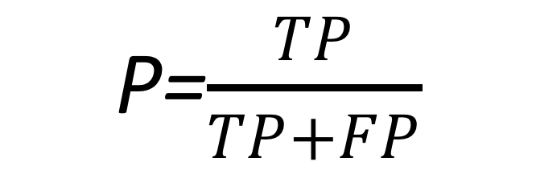
Classification Learning - Evaluation Criteria
Precision: Precision is used as a performance metric when the goal is to limit the number of false positives.
P=$\frac{TP}{TP+FP}$

Slide 22
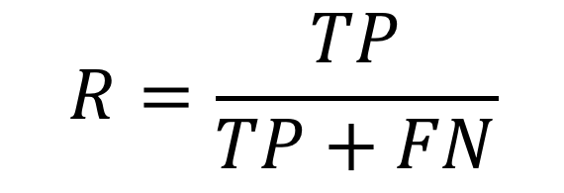
Classification Learning - Evaluation Criteria
Recall rate: The recall rate indicates how many the positive examples in the data are predicted to be correct. There are also two possibilities. One is to predict the original positive class as a positive class (TP), and the other is to predict the original positive class as a negative class (FN).
$$R=\frac{TP}{TP+FN}$$

Slide 23
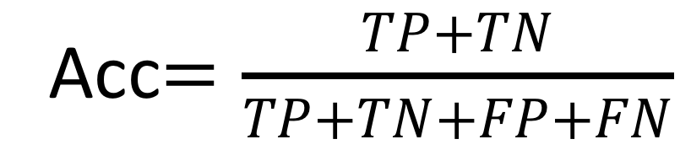
Classification Learning - Evaluation Criteria
Accuracy →
the number of correct predictions (TP and TN) divided by the number of all samples.
Acc$=\frac{TP+TN}{TP+TN+FP+FN}$

Slide 24
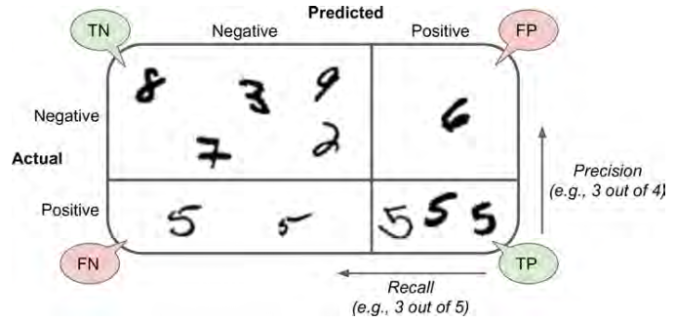
Classification Learning - Evaluation Criteria
Suppose we have 60 positive samples and 40 negative samples. We need to find all positive samples. The classification algorithm finds 50, of which only 40 are true positive samples. TP: 40; FN: 20; FP: 10; TN: 30.
Accuracy=(TP+TN)/(TP+FN+FP+TN)=70%
Precision=?
Recall=?

Slide 25
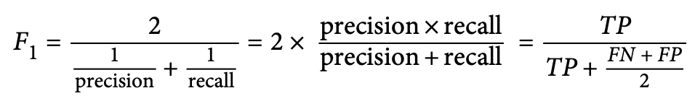
Classification Learning - Evaluation Criteria
It is often convenient to combine precision and recall into a single metric called the F1 score. The F1 score is the harmonic mean of precision and recall

Slide 26
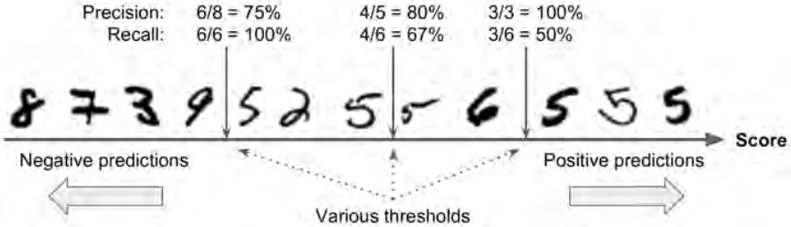
Classification Learning - Evaluation Criteria
Precision/Recall Tradeoff : Suppose the decision threshold is positioned at the central arrow (between the two 5s): you will find 4 true positives (actual 5s) on the right of that threshold, and one false positive (actually a 6). With that threshold:
precision = 80% (4 out of 5); the recall = 67% (4 out of 6).

Slide 27
Classification Learning - Evaluation Criteria
Precision/Recall Tradeoff
Now if you raise the threshold (move it to the arrow on the right), the false positive (the 6) becomes a true negative, thereby increasing precision (up to 100% in this case), but one true positive becomes a false negative, decreasing recall down to 50%. Conversely, lowering the threshold increases recall and reduces precision.

Slide 28
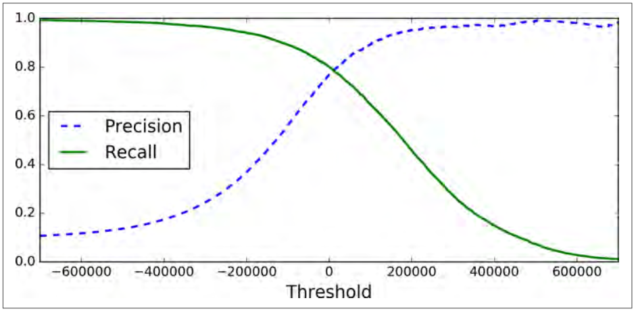
Classification Learning - Evaluation Criteria
Precision/Recall Tradeoff

Slide 29
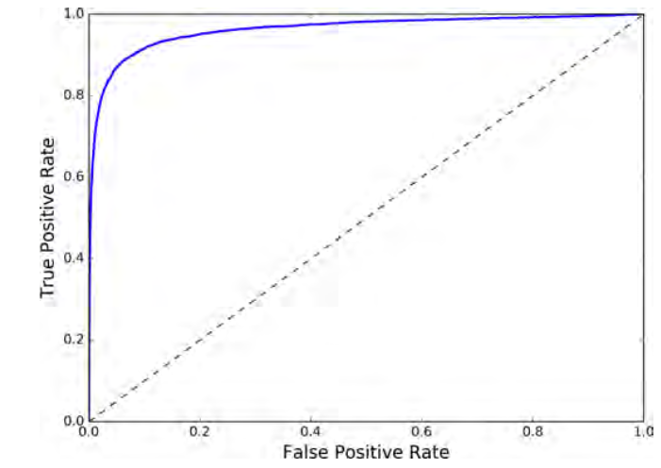
Classification Learning - Evaluation Criteria
Roc Curve
The receiver operating characteristic (ROC) curve is another common tool used with binary classifiers, which plots the true positive rate (another name for recall) against the false positive rate.

Slide 30
Classification Learning - Evaluation Criteria
Roc Curve
from sklearn.metrics import roc_curve fpr, tpr, thresholds = roc_curve(y_train_5, y_scores)
def plot_roc_curve(fpr, tpr, label=None):
plt.plot(fpr, tpr, linewidth=2, label=label) plt.plot([0, 1], [0, 1], 'k--’)
plt.axis([0, 1, 0, 1])
plt.xlabel('False Positive Rate') plt.ylabel('True Positive Rate')
plot_roc_curve(fpr, tpr)
plt.show()

Slide 31
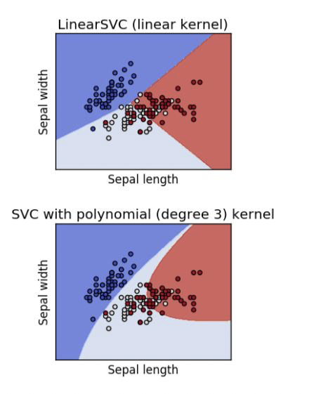
Sklearn vs. Classification
Different from the clustering algorithm being encapsulated in the sklearn.cluster module, the classification algorithm in the sklearn library is not uniformly encapsulated in a sub-module, so the import methods of the classification algorithm are different.

Slide 32
Sklearn vs. Classification
The classification functions provided by Sklearn include:
K nearest neighbors (KNN)
Naïve Bayes
Support Vector Machine (SVM)
Decision tree
Neural networks, etc.
There are linear classifiers and nonlinear classifiers.

Slide 33
Application of Classification Algorithm
Finance: Whether the loan is approved for evaluation
Medical diagnosis: determine whether a tumor is malignant or benign
Fraud detection: determine whether a bank transaction is suspected of fraud
Web page classification: Determine the category of the web page, finance or entertainment?

Slide 34
Regression Analysis
Regression: A method of statistically analyzing data to understand whether two or more variables are related,
to study their relative direction and intensity, and
to establish mathematical models
to observe specific variables to predict the variables that the researcher is interested in.

Slide 35
Regression Analysis
Regression analysis can help people understand the amount of change in the dependent variable as the independent variable changes.
In general, through regression analysis we can estimate the conditional expectation of the dependent variable from the given independent variable.

Slide 36
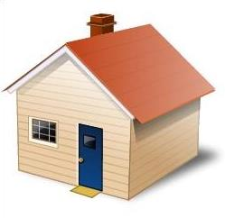
Regression Task
Area
Suburb/City
Number of rooms
Price?
Regressor
Price

Slide 37
Sklearn vs. Regression
The regression functions provided by Sklearn are mainly encapsulated in two sub-modules, namely sklearn.linear_model and sklearn.preprocessing.
Sklearn.linear_modlel encapsulates some linear functions, including linear regression functions:
Linear regression function
Ridge regression (Ridge)
Lasso
Nonlinear regression functions, such as polynomial regressions, are called by the sklearn.preprocessing submodule.

Slide 38
Regression Application
The regression method is suitable for predicting or trend fitting to some data with time series information, commonly used in finance and other fields involving time series analysis:
Stock trend forecasting
Traffic flow forecasting

Slide 39
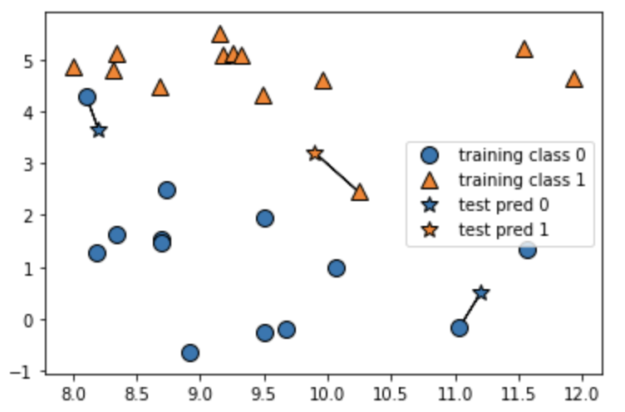
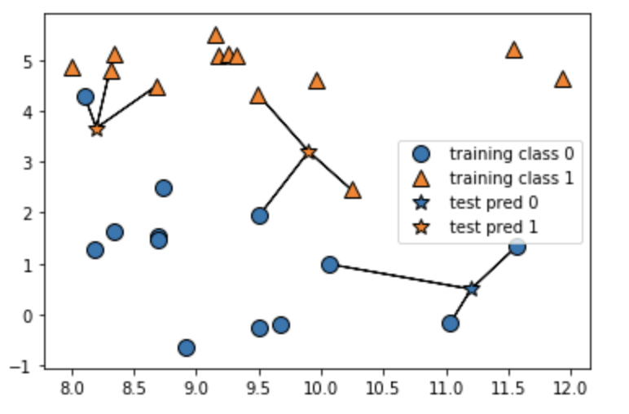
Hands On: P35-P44
import mglearn
mglearn.plots.plot_knn_classification(n_neighbors=1)
mglearn.plots.plot_knn_classification(n_neighbors=3)
Results of K=1 and K=3

Slide 40
#import train_test_split module
from sklearn.model_selection import train_test_split
X, y = mglearn.datasets.make_forge()
#get train and test data
X_train, X_test, y_train, y_test = train_test_split(X, y, random_state=0)

Slide 41
#import KNN module
from sklearn.neighbors import KNeighborsClassifier
clf = KNeighborsClassifier(n_neighbors=3)
clf.fit(X_train, y_train)

Slide 42
print ("Test set predictions:", clf.predict(X_test))
print ("Test set accuracy: {:.2f}".format(clf.score(X_test, y_test)))

Slide 43
Analyzing KNeighborsClassifier
#set figure size
%matplotlib inline
import matplotlib
import matplotlib.pyplot as plt
fig, axes = plt.subplots(1, 3, figsize=(10, 3))

Slide 44
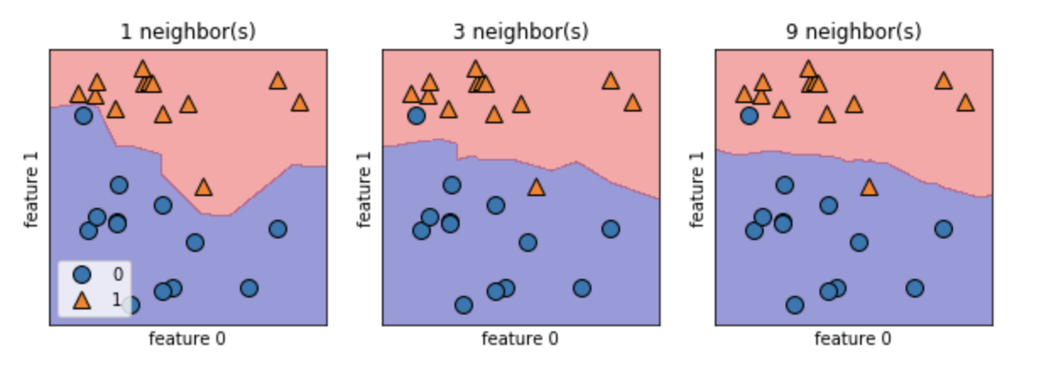
for n_neighbors, ax in zip([1, 3, 9], axes):
# the fit method returns the object self, so we can instantiate
# and fit in one line
clf = KNeighborsClassifier(n_neighbors=n_neighbors).fit(X, y)
mglearn.plots.plot_2d_separator(clf, X, fill=True, eps=0.5, ax=ax, alpha=.4)
mglearn.discrete_scatter(X[:, 0], X[:, 1], y, ax=ax)
ax.set_title("{} neighbor(s)".format(n_neighbors))
ax.set_xlabel("feature 0")
ax.set_ylabel("feature 1")
axes[0].legend(loc=3)

Slide 45
from sklearn.datasets import load_breast_cancer
# load breast cancer data
cancer = load_breast_cancer()
X_train, X_test, y_train, y_test = train_test_split(
cancer.data, cancer.target, stratify=cancer.target, random_state=66)
training_accuracy = []
test_accuracy = []
# try n_neighbors from 1 to 10
neighbors_settings = range(1, 11)

Slide 46
for n_neighbors in neighbors_settings:
# build the model
clf = KNeighborsClassifier(n_neighbors=n_neighbors)
clf.fit(X_train, y_train)
# record training set accuracy
training_accuracy.append(clf.score(X_train, y_train))
# record generalization accuracy
test_accuracy.append(clf.score(X_test, y_test))

Slide 47
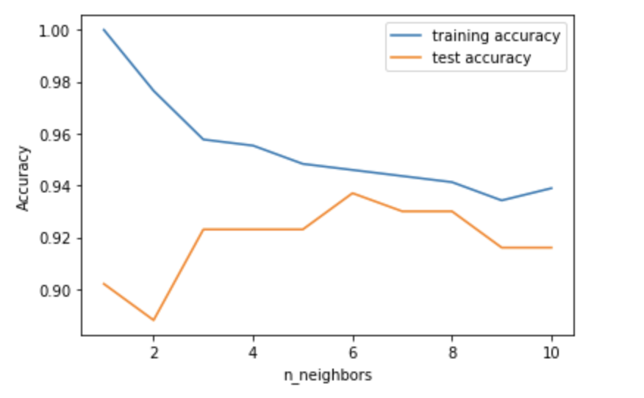
plt.plot(neighbors_settings, training_accuracy, label="training accuracy")
plt.plot(neighbors_settings, test_accuracy, label="test accuracy")
plt.ylabel("Accuracy")
plt.xlabel("n_neighbors")
plt.legend()

Slide 48
Quiz 1
Based on tutorials P35-P44
Load breast_cancer datasets for KNN classification
Please show the curve for training accuracy and test accuracy when K increases from 1 to 30
Please show the curve for training accuracy and test accuracy when K increases from 1 to 50

